Slide 1
Power-aware Deep Learning Model Serving with μ-Serve
MT25090

Slide 2
Introduction & Motivation
  Why Power Efficiency Matters in Model Serving?
Modern deep learning systems are no longer limited to training — they are continuously serving millions of inference requests in real time.
From chat bots to recommendation systems, model serving has become the dominant workload in cloud AI systems.
But this comes at a cost.
A significant portion of ML energy usage now comes from inference
Industry reports suggest up to 90% of ML compute demand is from inference workloads
The problem is no longer just performance —
it is about serving efficiently under strict latency requirements while minimizing power consumption.

Slide 3
The Core Problem & Gap
What Existing Systems Miss?
Most existing model-serving systems are designed with one primary goal:
maximize performance — either latency or throughput.
To achieve this, they rely on:
model parallelism
batching
replication
However, there is something they almost completely ignore: “GPU frequency as a controllable knob for power optimization”
Even though:
GPUs support frequency scaling
and lower frequencies can reduce power significantly
Current systems:
either keep frequency fixed
or use generic DVFS mechanisms that are not optimized for model serving
This leads to a key inefficiency: We are over-provisioning power without fully utilizing it

Slide 4
Challenges in Power-aware Model Serving
Challenge 1: Finding the Right GPU Frequency
Why Frequency Selection is Hard?
At first glance, reducing GPU frequency seems simple: “lower frequency → lower power.”
But in model serving, things are not that straightforward.
Every request must satisfy strict latency SLOs (Service Level Objectives).
So the real question becomes:
1.How low can we reduce frequency without violating latency?
This is difficult because:
different models behave differently
the same GPU may serve multiple models simultaneously
workload patterns keep changing
There is no single “optimal frequency” — it only depends on context.

Slide 5
Challenge 2: Non-deterministic Behavior
Why Generative Models Make It Worse?
Unlike traditional models, generative models (like GPT) behave very unpredictably.
Each request:
generates tokens one by one
execution time depends entirely on the output length
So even with the same input type: “execution time varies significantly”
This creates mainly two problems:
Hard to predict latency impact of frequency scaling
Scheduling becomes inefficient (e.g., FCFS causes blocking)
The system cannot easily tell whether latency increase is due to:
lower GPU frequency
OR
inherent randomness of the model

Slide 6
Challenge 3: Lack of Fine-grained Control
GPU Limitation: One Frequency for Everything?
Unlike CPUs, GPUs do not allow fine-grained frequency control.
That means:
multiple model partitions share the same GPU
frequency is decided by the most demanding workload
Even if some parts of the model don’t need high frequency, they are forced to run at higher power.
This leads to mainly 2 things:
wasted energy
missed optimization opportunities

Slide 7
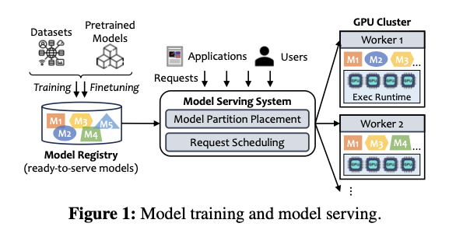
Background & System Overview
How Model Serving Works
From Training to Serving
The lifecycle of a deep learning model has two main phases:
Training
Serving (Inference)
The serving phase follows a request-response pattern:
Users send queries
System schedules them
GPUs process them
Results are returned
From the figure:
Left side → training + model registry
Right side → serving system + GPU cluster
Workers execute model partitions
Key takeaway: Serving is continuous, dynamic, and latency-sensitive.

Slide 8
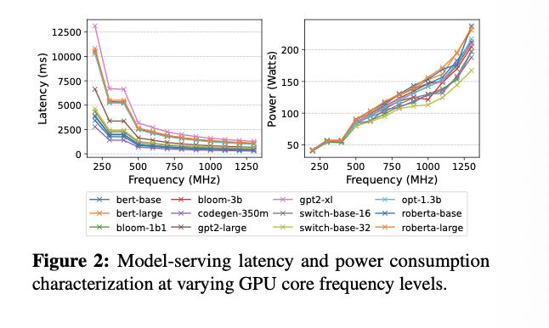
Power vs Frequency Behaviour
Where Power Saving Opportunity Comes From?
From the figure:
Left graph → latency vs frequency
Right graph → power vs frequency
As frequency increases:
latency improves rapidly at first
then stabilizes (diminishing returns)
But power increases almost linearly which mismatch is the key insight.
“Even if we reduce frequency slightly, latency barely changes, but power drops significantly.”
This creates a sweet spot for optimisation.

Slide 9
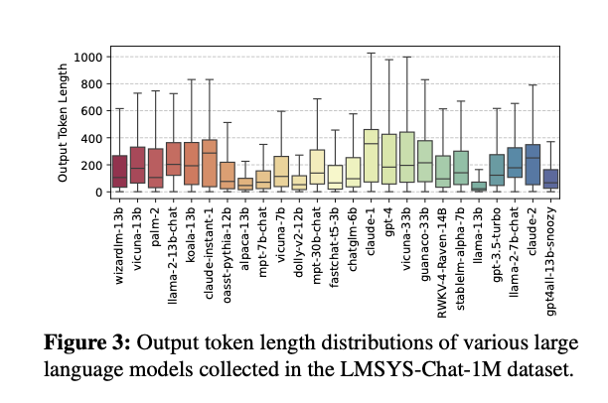
Non-determinism in Real Workloads
Why Scheduling Becomes Difficult?
From the figure:
It shows output token length distribution for LLMs.
Key observation:
Huge variation in output length
Some responses are very short
others are extremely long
Since execution time is directly proportional to the output length:
This leads to:
unpredictable latency
scheduling inefficiencies
This is why naive scheduling First Come First Serve (FCFS) fails.

Slide 10
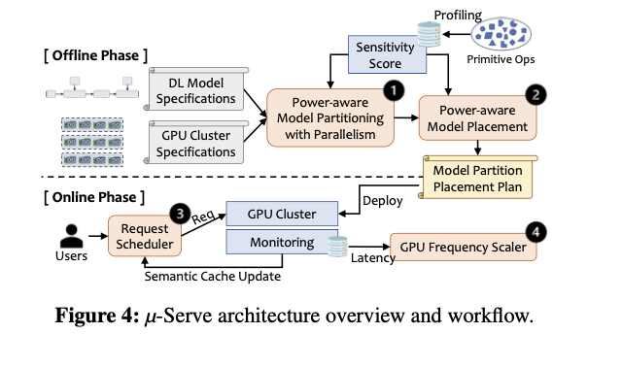
μ-Serve Overview
μ-Serve: A Power-aware Model Serving Framework
Modern model serving systems focus more on latency and throughput but μ-Serve introduces a different perspective :” power as a first-class concern.”
At a high level, μ-Serve is designed to:
reduce energy consumption in GPU clusters
maintain strict latency SLOs
intelligently adapt to workload behavior
The system is structured into two major phases:
an offline phase for preparation and optimization
an online phase for real-time decision making

Slide 11
Offline Phase (Design-time Optimization)
Building the Foundation Before Execution
Before serving begins, μ-Serve performs detailed analysis of models and hardware.
It starts by profiling primitive operators, measuring how sensitive each one is to GPU frequency changes.
This sensitivity becomes the key signal for later decisions.
Using this information, the system:
partitions models into smaller components based on behavior
avoids mixing operators with very different sensitivities
places these partitions across GPUs in a way that maximizes flexibility
The result is a deployment plan that is already optimized for power-aware execution.

Slide 12
Online Phase (Runtime Adaptation)
Adapting to Workloads in Real Time
Once the system is live, μ-Serve continuously reacts to incoming requests.
Instead of treating all requests equally, it:
schedules them intelligently based on expected execution time
monitors latency against SLO targets
dynamically adjusts GPU frequency at runtime
When the system detects slack in latency: it reduces GPU frequency to save power
When latency is at risk it scales frequency back up immediately.
This continuous feedback loop allows μ-Serve to balance efficiency and performance without manual tuning

Slide 13
Operator Sensitivity
Understanding Operator Sensitivity
A central observation in this work is that not all parts of a model behave the same way.
When GPU frequency is reduced:
some operators show a significant increase in latency
others remain relatively unaffected
Interestingly, operators that are less sensitive often contribute less to the overall execution time of a request.
This means that treating the model as a uniform block leads to unnecessary power usage.

Slide 14
Turning Insight into Strategy
From Observation to Optimisation
μ-Serve leverages this variation by reorganising how models are deployed.
Instead of randomly partitioning models:
it groups operators with similar sensitivity together
ensures each GPU handles workloads with comparable behaviour
This avoids a common inefficiency where:
a single sensitive component forces the entire GPU
to operate at a higher frequency
By aligning workloads with similar characteristics, μ-Serve enables more aggressive and safe power reduction.

Slide 15
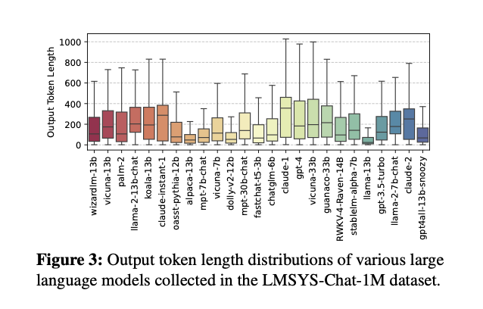
Scheduling + Prediction (μ-Serve Intelligence Layer)
Why Scheduling Becomes a Problem
The Hidden Issue: Unpredictable Request Execution
In model serving, especially with generative models, requests do not take the same amount of time to complete.
This is because:
responses are generated token by token
longer outputs directly increase execution time
Even for the same model, two requests can behave very differently.
This variability creates a major issue:
traditional scheduling like FCFS (First Come First Serve)
leads to head-of-line blocking
shorter requests get stuck behind longer ones
As a result, both latency and power efficiency suffer.

Slide 16
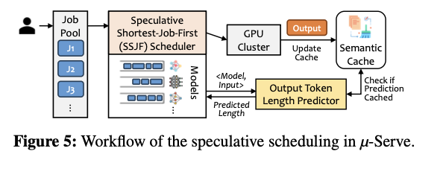
μ-Serve’s Scheduling Idea
Smarter Scheduling with Prediction
To overcome this, μ-Serve introduces a Speculative Shortest-Job-First (SSJF) approach.
Instead of executing requests blindly:
the system first estimates how long each request will take
then prioritises shorter jobs
This improves:
overall latency
system throughput
and indirectly creates more opportunities for power saving
The key challenge here is: How do we know the job length before executing it?

Slide 17
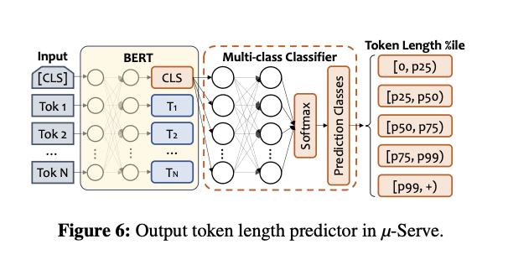
Output Length Predictor
Predicting Execution Time Before It Happens
μ-Serve solves this using a lightweight proxy model.
Instead of running the full model:
a smaller model (based on BERT) is used
it predicts the expected output length of a request
Since execution time is roughly proportional to output length, this prediction becomes a strong estimate of job duration.
To simplify prediction:
outputs are grouped into ranges (like short, medium, long)
instead of predicting exact token counts
This makes the system both efficient and practical!.

Slide 18
Making Prediction More Reliable
Improving Accuracy with Smart Tricks
Prediction alone is not always enough, so μ-Serve adds a few enhancements.
First, it uses a semantic cache:
if a similar request was seen before
the system reuses the known output length
Second, it combines:
prediction for new inputs
cached values for repeated inputs
This hybrid approach:
improves scheduling accuracy
reduces unnecessary computation
Overall, scheduling becomes more predictable, which directly helps in better power management.

Slide 19
GPU Frequency Scaling (Core Mechanism)
Why Frequency Scaling Matters
Turning Power into a Controllable Variable
GPU frequency directly influences both performance and power consumption. Higher frequency improves latency, but it also increases power usage almost linearly.
However, model-serving workloads do not always require peak performance.
There are many situations where:
latency is well within SLO limits
GPUs are effectively over-provisioned
This creates an opportunity to:
reduce frequency → save power → without hurting performance
The challenge is doing this safely and dynamically, since workloads continuously change.

Slide 20
How μ-Serve Adjusts Frequency
Feedback-driven Frequency Control
μ-Serve continuously monitors how each model performs with respect to its latency SLO.
For every model partition, it calculates a value called latency slack:
If slack is small or negative → system is close to violating SLO
If slack is large → there is room to reduce frequency
Based on this observation:
frequency is increased when performance is at risk
frequency is decreased when there is safe margin
This creates a feedback loop where the system constantly adapts to maintain balance between power and performance.

Slide 21
MIAD Strategy The Key Idea
Conservative Down, Aggressive Up
μ-Serve uses a strategy inspired by network congestion control, called Multiplicative Increase, Additive Decrease (MIAD).
The behavior is intentionally asymmetric:
When increasing frequency:
→ the system reacts aggressively
→ frequency is doubled quickly to avoid SLO violations
When decreasing frequency:
→ the system acts cautiously
→ frequency is reduced gradually in small steps
This design ensures:
quick recovery from performance issues
safe and stable power reduction

Slide 22
Why This Works Well
Stability + Efficiency Together
This approach is effective because it aligns with workload behaviour.
sudden spikes in demand require fast response
but power saving should not introduce instability
By combining monitoring with adaptive scaling, μ-Serve achieves:
consistent SLO satisfaction
reduced energy consumption
minimal oscillations in system behaviour
Another important aspect is that scaling decisions are made per GPU device, considering all model partitions running on it.
This ensures that frequency changes reflect actual workload conditions.

Slide 23
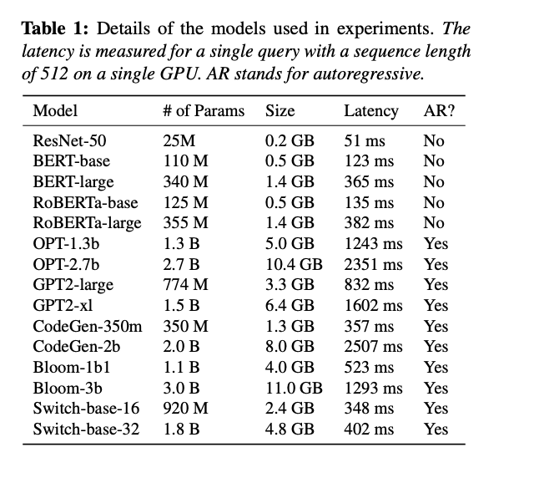
Evaluation & Results (Impact Section)
Experimental Setup (Context Before Results)
How μ-Serve Was Evaluated?
To evaluate μ-Serve, experiments were conducted on a GPU cluster with real-world workloads and diverse deep learning models.
The setup includes:
an 8-node cluster with 16 GPUs (NVIDIA V100)
a mix of models: CNNs, Transformers, and generative models
real workload traces from Azure and production datacenters
Each model has different:
size
latency
execution characteristics
This diversity ensures the evaluation reflects real deployment scenarios.

Slide 24
Power Savings (Main Result)
How Much Power Can Be Saved?
The most important result is the reduction in power consumption while maintaining performance.
Observations from the graph:
μ-Serve consistently reduces power across different scenarios
savings range from 1.5× to 2.6× depending on workload conditions
greater savings occur when:
  SLO constraints are less strict
  system load is lower
This shows that μ-Serve effectively utilises unused performance headroom to save energy.

Slide 25
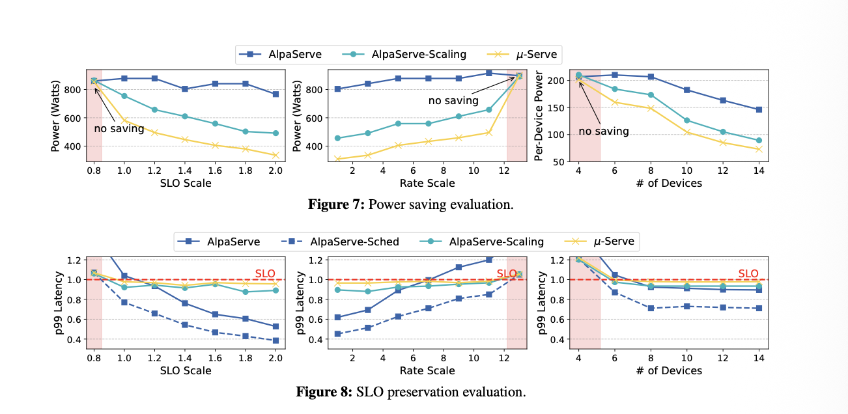

Slide 26
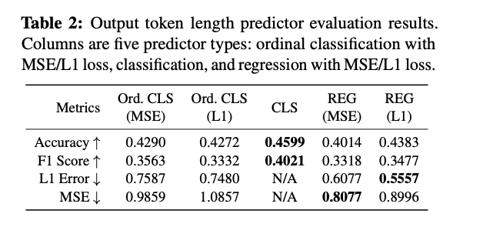
Maintaining Performance (SLO Analysis)
Does Power Saving Hurt Performance?
Power reduction is only useful if performance remains acceptable.
From the results:
μ-Serve maintains 99% SLO attainment in most cases
latency increase is minimal (around 2–9%)
in some cases, scheduling even improves latency
This demonstrates that:
power savings are achieved without violating user-facing requirements

Slide 27
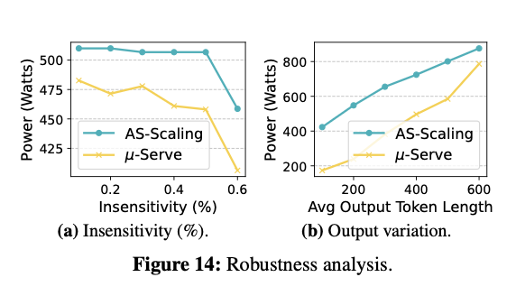

Slide 28
Key Takeaways from Evaluation
What Do We Learn from the Results?
The evaluation highlights three important conclusions:
First, dynamic GPU frequency scaling alone already saves power, but combining it with intelligent scheduling and placement gives significantly better results.
Second, workload characteristics matter:
relaxed SLOs → more power-saving opportunities
higher load → tighter constraints
Finally, μ-Serve shows that: power optimisation is not a trade-off with performance but can be achieved through system-level coordination.

Slide 29
Conclusion
Final Thoughts
μ-Serve introduces a new way of thinking about model serving:
Instead of maximising performance alone, it balances power, latency, and system behaviour together.
By combining:
operator-level insights
intelligent scheduling
dynamic frequency scaling
it achieves:
significant energy savings
stable performance
better resource utilisation
This work highlights that future AI systems must be designed not just for speed, but also for efficiency at scale.

